Slide 1

Predicting Rainfall with Machine Learning
By Lynne, Naresh, Deepak, Mridul
DS207 Spring 2025
April 17 2025
Dataset: Kaggle · Playground Prediction Competition
https://github.com/lwang9/mids-w207-final_project_team2

Slide 2
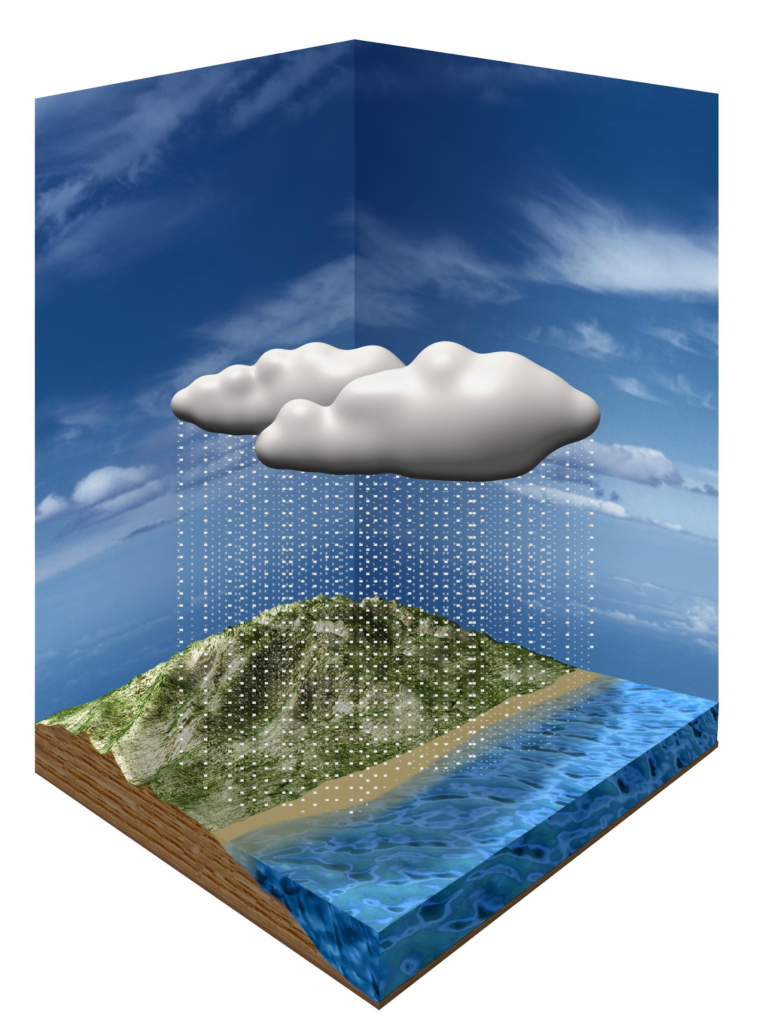
Motivation
Question: Will it rain on any given day?
Why is it interesting? Real-World Impact:
Agriculture.
Disaster preparedness.
Urban planning.
Commute/travel planning.
. . . .
Reference: Generated by chatgpt

Slide 3

Previous Forecasting Methods
Numerical Weather Prediction (NWP) Models.
Statistical Models.
Satellite-Based Models.
https://www.pivotalweather.com
Notes:
Numerical Weather Prediction (NWP) Models: These use mathematical equations to simulate atmospheric processes. Examples include the Global Forecast System (GFS) and the European Centre for Medium-Range Weather Forecasts (ECMWF) models.
Statistical Models: These rely on historical weather data and statistical methods to predict rainfall patterns. They are often used for seasonal forecasts.
Machine Learning Models: More recently, machine learning techniques have been applied to improve rainfall predictions by analyzing large datasets and identifying patterns.
Satellite-Based Models: These use satellite observations to estimate precipitation and predict rainfall, especially in remote areas.
Hydrological Models: These focus on the interaction between rainfall and water systems, helping predict floods and manage water resources.

Slide 4

Binary Classification
Given Input Features:
ID, day, pressure, maxtemp, temperature, mintemp, dewpoint, humidity, cloud, sunshine, wind direction, windspeed (2190 rows)
Output: rainfall
1 = rain, 0 = no rain
Reference: Generated by chatgpt

Slide 5
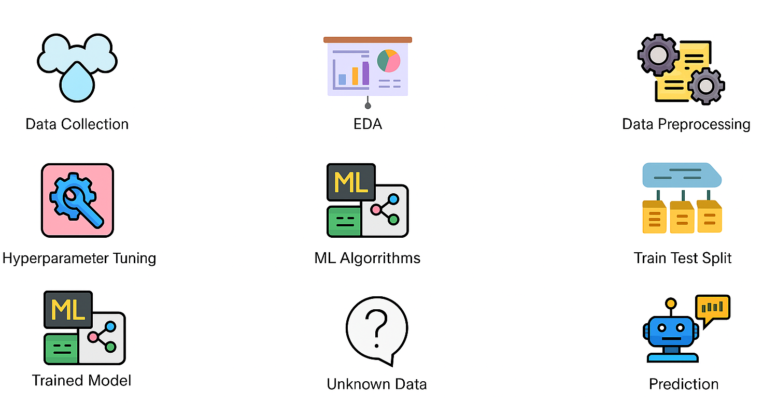
Overall Plan
Train Val Split
Test Data

Slide 6
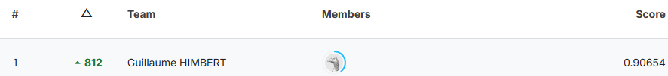
Summary of Findings
Many models perform reasonably well.
Ensemble modeling achieved near-top leaderboard performance on Kaggle (rank 21/4382).
Notes:
Train/Val - 80:20 - 2160
LR - 88/88/89
KNN - 89/89/87
CNN - 88/88/89
XGBoost - 96/87/88
Ensemble - 89/89
Accuracy, precision, recall and f-score

Slide 7
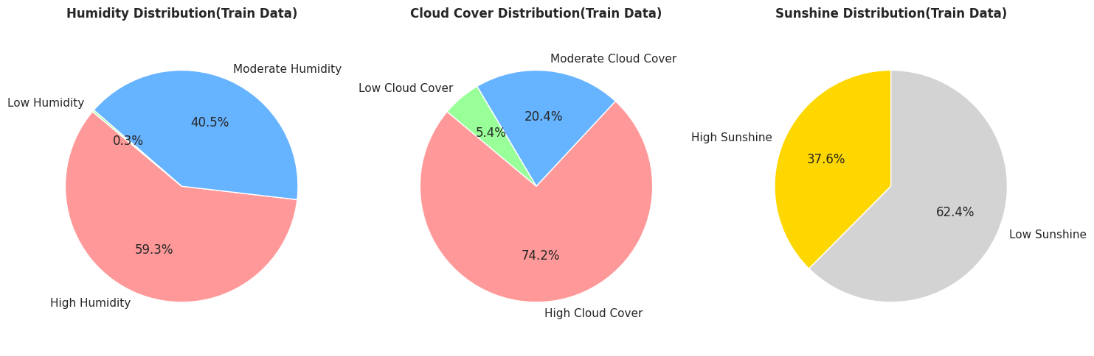
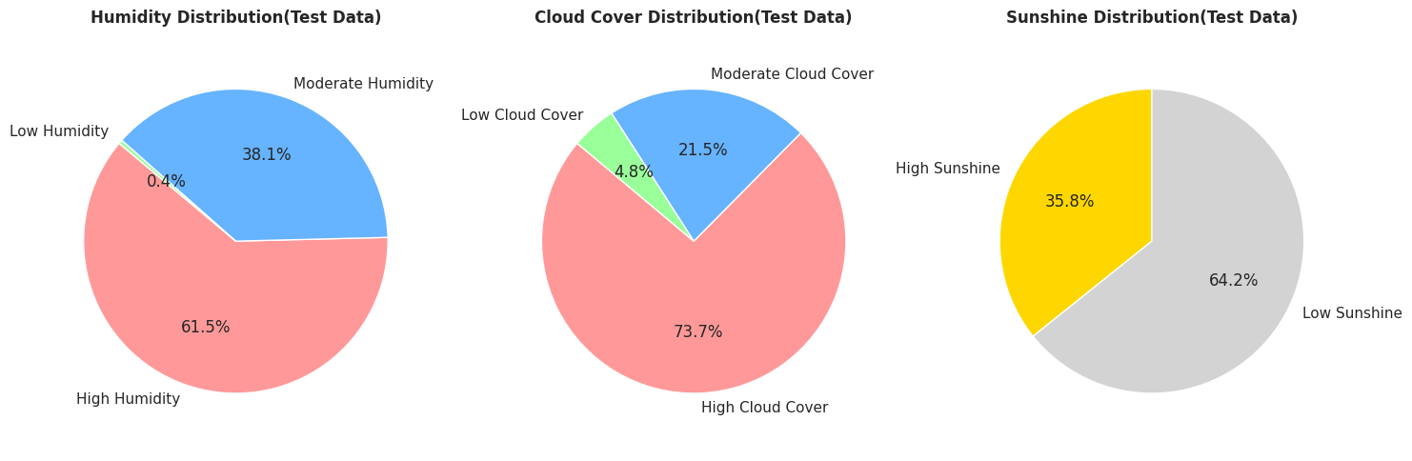
EDA - Comparison of key variables ( train & test )
Train Data
Test Data

Slide 8
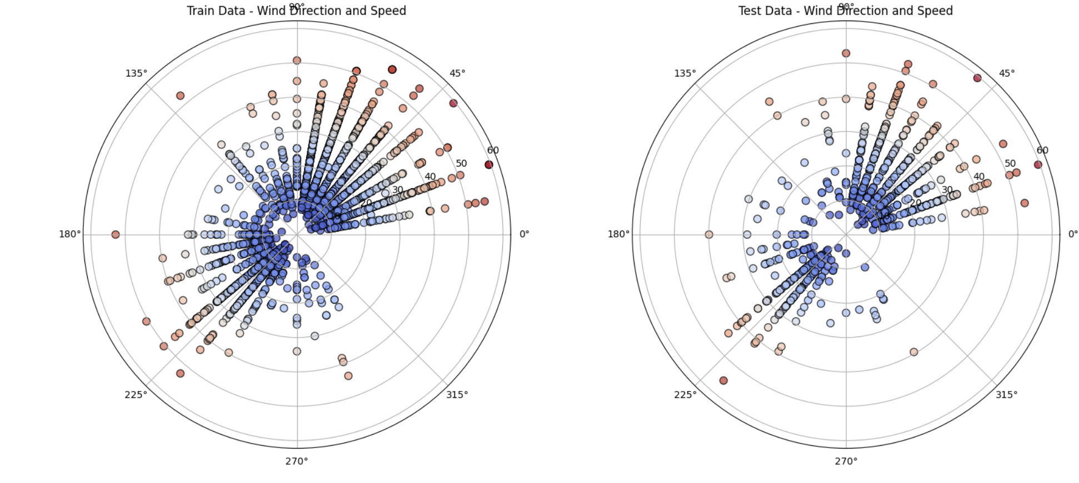
EDA - Wind Direction & Speed
Train Data
Test Data

Slide 9
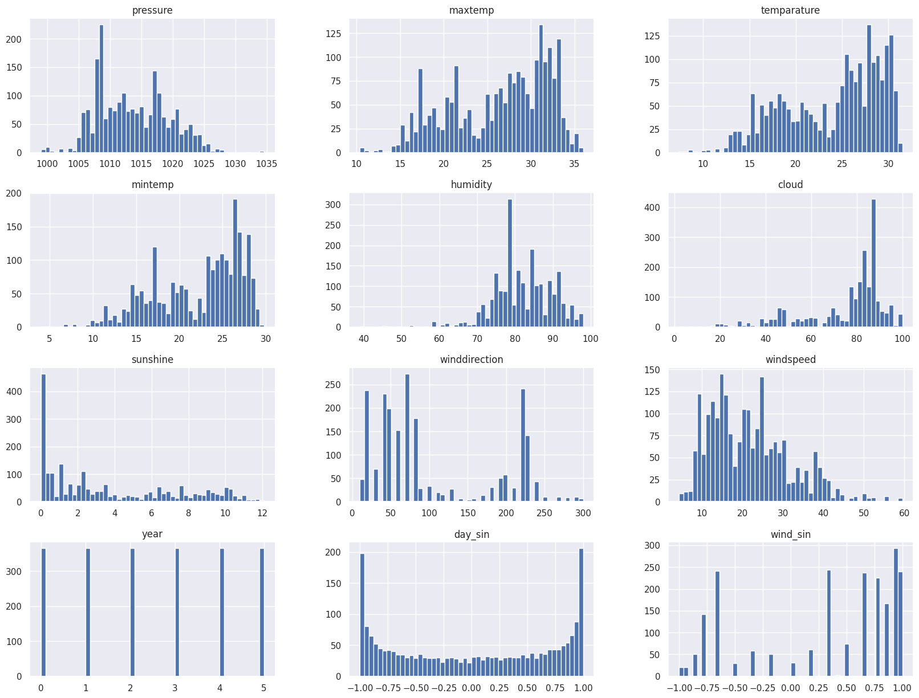
EDA - Distribution of Given Features (Train Data)
Notes:
Some of the distributions are right or left skewed
OLS kind this matters if it is normally distributed or not, otherwise we need to do log transforms
Rainfall 0/1 are not evenly distributed. It rains most of the days.
But for predictive model like ours(LR, NN etc) we can use as is

Slide 10
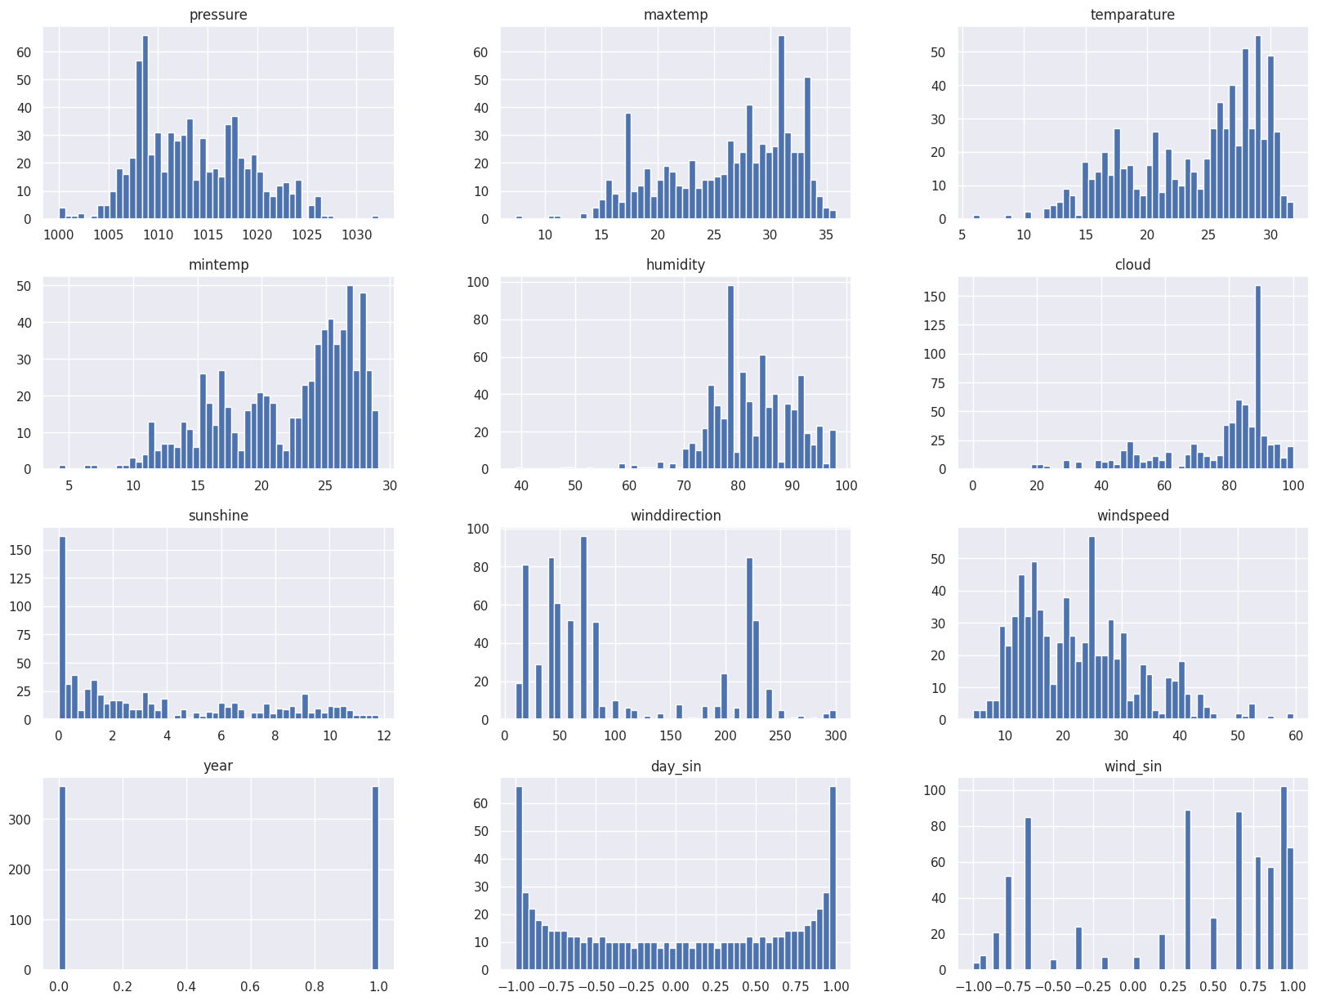
EDA - Distribution of Given Features (Test Data)
Notes:
Some of the distributions are right or left skewed
OLS kind this matters if it is normally distributed or not, otherwise we need to do log transforms
Rainfall 0/1 are not evenly distributed. It rains most of the days.
But for predictive model like ours(LR, NN etc) we can use as is

Slide 11
EDA - Data Preprocessing and Transformation
Input Features: [‘day’, 'pressure', 'maxtemp', 'temperature', 'mintemp', 'humidity', 'cloud', 'sunshine', 'winddirection', 'windspeed']
Additional Features:
wind_sin – a sine transformation of the wind direction to encode it cyclically: 2*pi*winddirection/360
day_sin – a sine transformation of the day to capture seasonal cycles: 2*pi*day/365
year – Synthetic year assigned based on index or grouping.
month – Extracted from the synthetic date derived from day
Notes:
New feature creation - cyclic features
Drop day/month

Slide 12
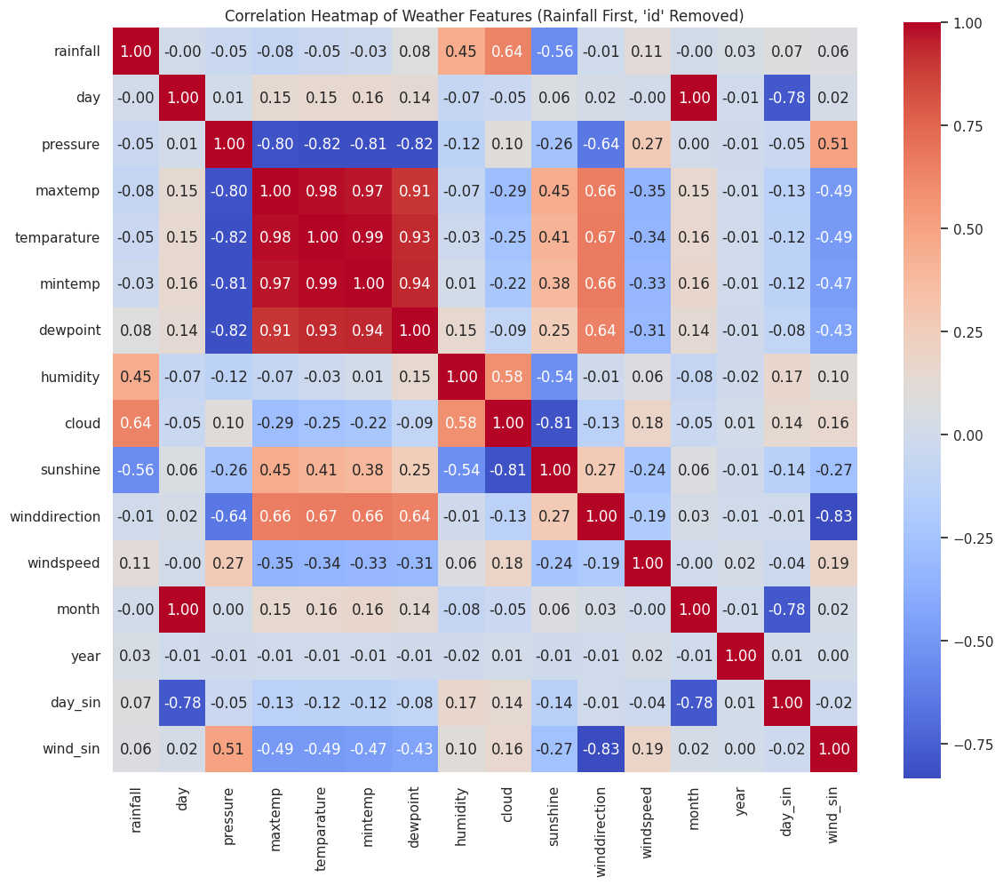
EDA - Linear Relationships
All Features: [‘day’, 'pressure', 'maxtemp', 'temperature', 'mintemp', 'humidity', 'cloud', 'sunshine', 'winddirection', 'windspeed', ‘month’, ‘year’, ‘wind_sin’, ‘day_sin’]
Relevant Features: ['pressure', 'maxtemp', 'temperature', 'mintemp', 'humidity', 'cloud', 'sunshine', 'winddirection', 'windspeed', ‘year’, ‘day_sin’, ‘wind_sin’]
Irrelevant Features: [‘day’, ‘month’]
Additional Features to Test: Previous day(s)’ Features
Notes:
Correlated features to be dropped (big red box - explain)
Previous day features leading to a small bump in performance

Slide 13
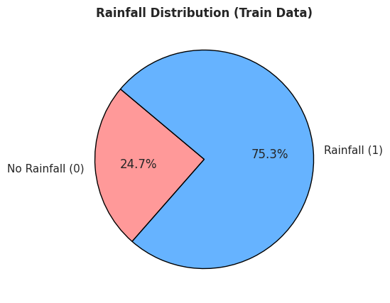
Modeling - Baseline
Train/Val Split
80/20
Random / Sequential
If a model always predicts rainfall = 1, the accuracy is 75.3%
A basic Logistic Regression model (without feature engineering) improves the accuracy to 86%
Notes:
New feature creation - cyclic features
Drop day/month

Slide 14
Modeling - Improvement
Model | Validation Accuracy | Test Score
Logistic Regression | 0.8837 | 0.8961
KNN | 0.8744 | 0.8716
Decision Tree | 0.8676 | 0.8556
Random Forest | 0.8744 | 0.8958
XGBoost | 0.8721 | 0.8998
Neural Network | 0.8790 | 0.9014
1D CNN | 0.8833 | 0.8916
2D CNN | 0.8787 | 0.8879
LSTM | 0.8767 | 0.8959
GRU | 0.8699 | 0.8972
Ensemble | — | 0.9038
Notes:
Train/Val - 80:20 - 2160
LR - 88/88/89
Naresh
KNN - 89/89/87
CNN - 88/88/89
XGBoost - 96/87/88
Ensemble - 89/89
Accuracy, precision, recall and f-score

Slide 15
Experiments
Classic Models:
Logistic Regression, Decision Tree, Random Forest, XGBoost, KNN
Neural Net Models:
NN, 1D CNN, 2D CNN, LSTM, GRU
Ensemble:
Weighted average of different models
Notes:
Classic Models:
Tabular weather features (e.g., temperature, humidity, wind)
Small to medium datasets
Structured historical rainfall features (aggregated, engineered)
Neural Net/ DL Models:
Raw time series of weather features (e.g., 30-day sliding windows)
When sequence matters
Larger datasets
—---------------------
NN (MLP) Can learn non-linear interactions - Needs more data, no sequence handling
1D CNN Extracts local temporal patterns (sliding window) - Needs tuning of kernel size; less global sequence modeling
2D CNN Used when reshaping data into image or grid (e.g., satellite) - Not natural for pure tabular time-series
LSTM Captures long-term dependencies in sequences - Slower to train, may overfit on small data
GRU Lighter, faster LSTM variant - Slightly less expressive than LSTM
Ensemble: Weighted sum of probabilities from different models which Deepak will cover
Train/Val - 80:20 - 2160
Baseline - 75% accurate on validation
LR - 88/88/89 - Simple logistic regression with tuned hyperparameters to classify an observation to rain vs no-rain
KNN - 89/89/87 - The basic idea is to create a feature vector per observation in the embedding space (which is labeled) . Then match the incoming test observation with top K nearest vectors in this space and assign majority label.
CNN - 88/88/89 - Use a 1D convnet or 2D convnet with tuned kernel sizes to produce feature and their relations and then classify into rain vs no-rain.
XGBoost - 96/87/88 - Use a set of weak learners to improve the model incrementally
Ensemble - 89/89 - combine the results from all of the above techniques.
Accuracy, precision, recall and f-score

Slide 16
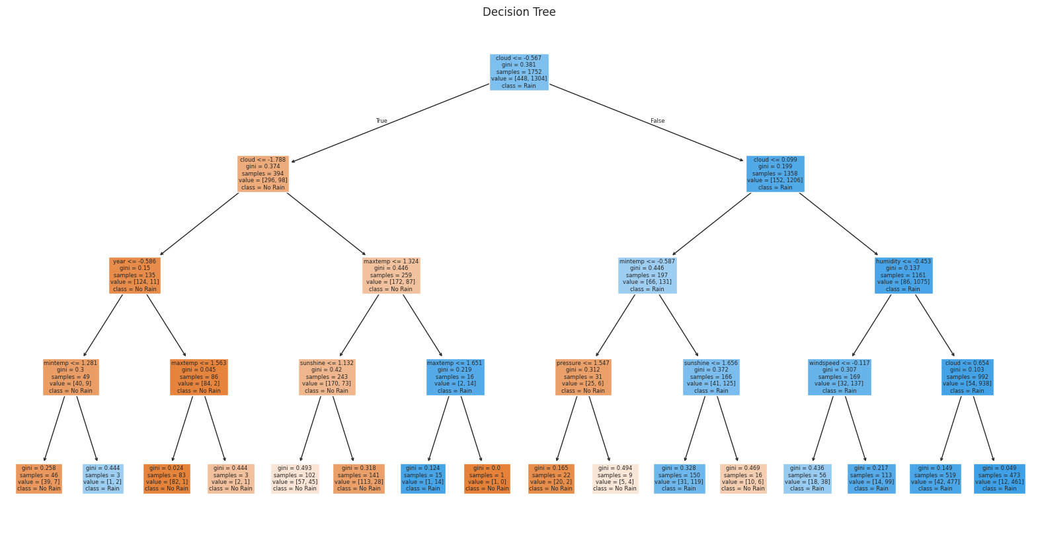
Hyperparameter Choices – Decision Trees
Max_depth = 4
Notes:
Random Search - Samples random combinations - Fast, better in high dim - Still trial-and-error

Slide 17
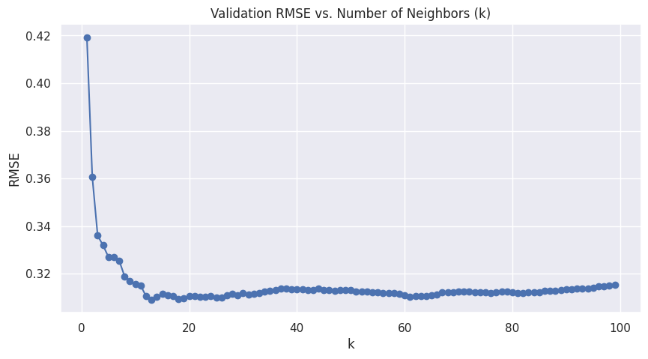
Hyperparameter Choices - KNN
K = 15
Notes:
Mridul

Slide 18
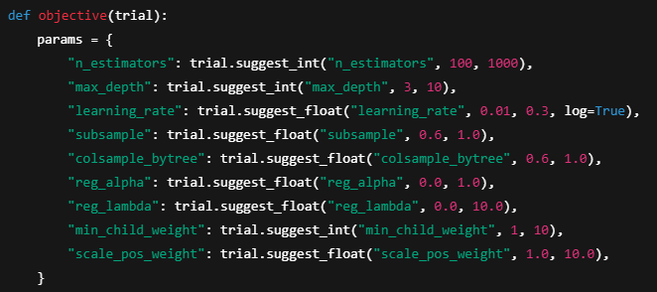
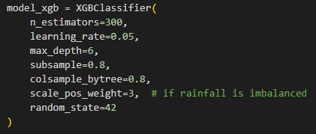
Hyperparameter Choices - XGBoost
Notes:
Mridul
Hyperparameter tuning:
Grid search - Exhaustive over a parameter grid - Simple, parallelizable - Expensive, slow
Optuna (Bayesian) - Smart sampling via Bayesian Optimization Algorithm- Efficient in high dimensions, learns good zones - More setup, needs pruning
Instead of randomly trying hyperparameters, TPE learns from past trials to choose the next best configuration more intelligently.
Imagine learning_rate = 0.001 consistently leads to high accuracy. TPE will sample more around 0.001 and less around poor values like 0.1. Helps in pruning.
From range for each hyperparameter -> Best hyperparameters

Slide 19
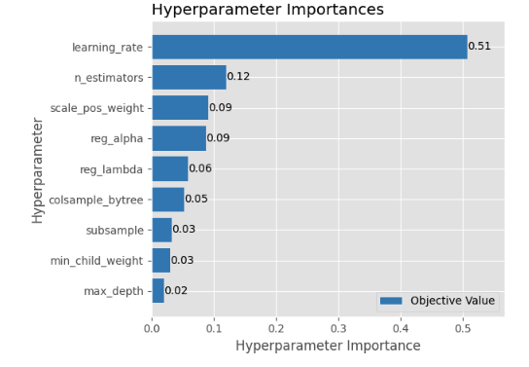
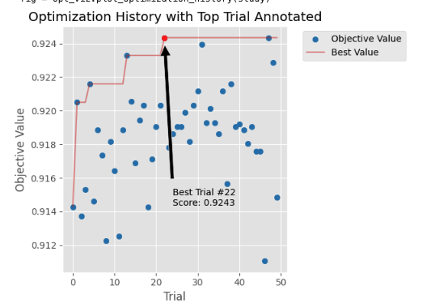
Hyperparameter Choices - XGBoost
Notes:
Mridul
X-axis
The relative importance score of each hyperparameter
It’s a value between 0 and 1 (often summing to 1), indicating how much that hyperparameter influenced the objective value across all trials
A higher value = more influence on the objective (e.g., accuracy, auc)
Y-axis (each bar)
Represents a specific hyperparameter you tuned (e.g., learning_rate, max_depth)
—---
Use this to prioritize future tuning or simplify your search space!
XGBoost
Objective value: auc - Insensitive to threshold, robust to imbalance
Most AUC gains in this experiment came from tuning the learning rate, followed by adjusting tree count and class imbalance weight.
Surprisingly, tree structure (max_depth, min_child_weight) had little impact — suggesting AUC was driven more by optimization dynamics than tree depth.
Params: {'n_estimators': 579, 'max_depth': 4, 'learning_rate': 0.0419040355824214, 'subsample': 0.9765209337634819, 'colsample_bytree': 0.6662418067072496, 'reg_alpha': 0.6998595811201204, 'reg_lambda': 2.744958985622577, 'min_child_weight': 10, 'scale_pos_weight': 3.1446884884600026}
Every Optuna plot (optimization history, parallel plot, slice, importance) shows AUC values on the Y-axis under "objective value"
Hyperparameter
Importance
Description
learning_rate
0.51
How fast the model learns. Small values slow but steady; large values can overshoot. Most impactful here.
n_estimators
0.12
Number of boosting rounds (trees). More trees can help, but only if learning rate is small.
scale_pos_weight
0.09
Adjusts for class imbalance. Higher = more emphasis on positive class (rain).
reg_alpha (L1)
0.09
L1 regularization. Can push some weights to zero (feature selection).
reg_lambda (L2)
0.06
L2 regularization. Helps avoid overfitting by penalizing large weights.
colsample_bytree
0.05
% of features used per tree. Lower = more randomness, potentially less overfitting.
subsample
0.03
% of rows (data points) used per tree. Again controls variance and overfitting.
min_child_weight
0.03
Minimum sum of instance weight in a child node. Higher values make the algorithm more conservative.
max_depth
0.02
Maximum tree depth. Controls model complexity. Surprisingly unimportant here.

Slide 20
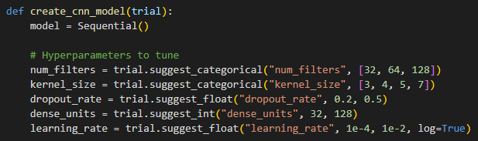
Hyperparameter Choices - 1D CNN
Notes:
Deepak:
Best for -Sequential data/ time series
The input is a 1D tensor of shape (timesteps, features).
Convolution happens only along one axis — typically the time or sequence axis.
Filters slide over time steps to capture temporal patterns.
Number of filters:Controls how many features are learned per layer.
Kernel size:Length/shape of the filter. Affects feature granularity.
Dropout rate:Helps prevent overfitting by randomly dropping neurons.
Dense layer units:Number of units in fully connected layers.
Learning rate:Crucial for training dynamics.

Slide 21
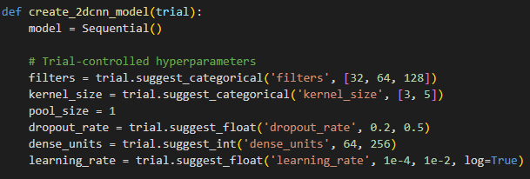
Hyperparameter Choices - 2D CNN
Notes:
Deepak
Best for: Spatial data
Input is a 3D tensor
Convolution happens across two axes
Filters capture spatial patterns, like edges, textures, and shapes.
Number of filters: Controls how many features are learned per layer.
Kernel size:Length/shape of the filter. Affects feature granularity.
Pooling size:Downsamples the feature maps. Reduces dimensionality.
Dropout rate:Helps prevent overfitting by randomly dropping neurons.
Dense layer units:Number of units in fully connected layers.

Slide 22
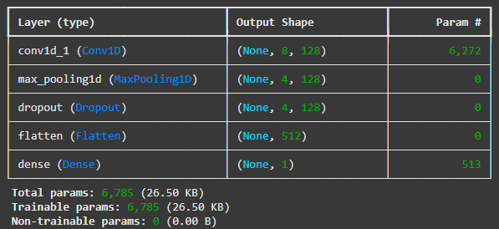
Hyperparameter Choices – 1D CNN, 2D CNN
2D CNNs are not better than 1D CNNs
Deeper CNNs are not better than shallower CNNs
Best 1D CNN
Filter = 128.
Kernel_size = 4.
Stride = 1
Learning_rate = 0.0005.
Activation = ‘relu’
Dropout rate = 0.5
Notes:
Deepak

Slide 23
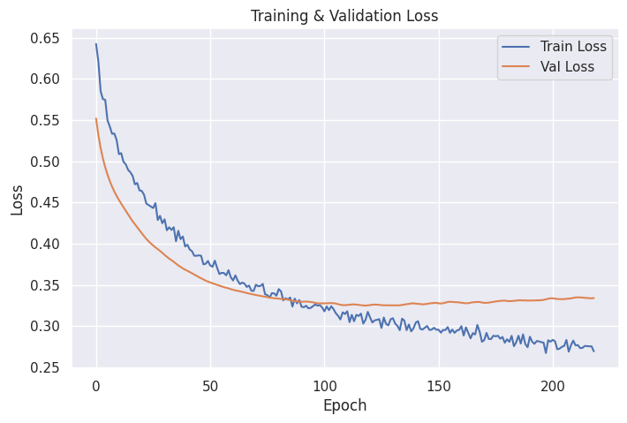
Hyperparameter Choices – 1D CNN
Early_stopping
Patience = 100
Epochs = 300
Batch_size 1024
Notes:
Deepak:
Early Stopping: Enabled
Patience: 100 epochs → Training will stop if validation loss doesn’t improve for 100 consecutive epochs.
Max Epochs: 300 → Training can run for up to 300 epochs unless stopped early.
Batch Size: 1024 → Model updates weights after processing every 1024 samples.

Slide 24
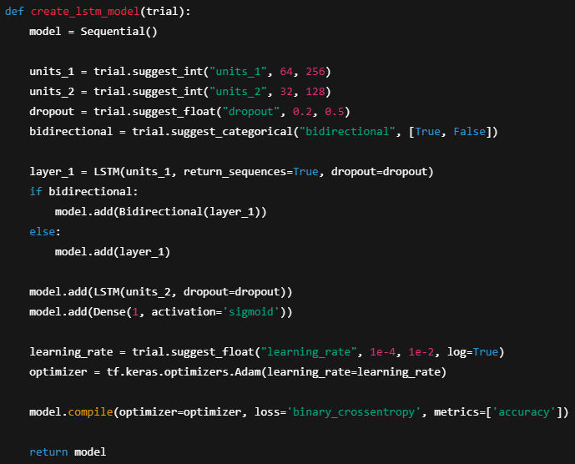
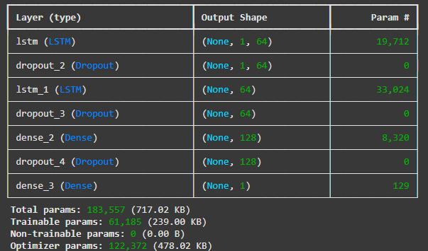
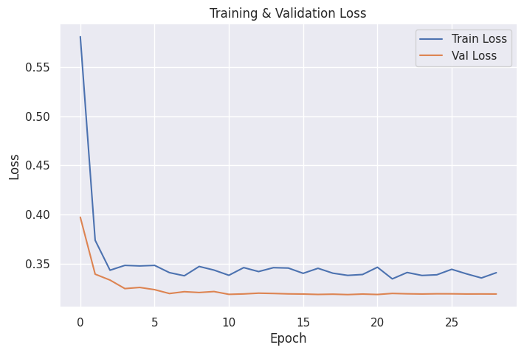
Hyperparameter Choices - LSTM
Notes:
Deepak:
LSTM (Long Short-Term Memory) is a special kind of Recurrent Neural Network (RNN) designed to model sequential data and capture long-range dependencies
Each LSTM unit has a memory cell and three gates:
Forget Gate (𝑓ₜ): Decides what information to discard from the previous cell state.
Input Gate (𝑖ₜ): Decides what new information to store in the cell.
Output Gate (𝑜ₜ): Controls what information to output from the cell state.
Hyperparamters:
units:Number of neurons
bidirectional:Whether to wrap the LSTM in a Bidirectional layer for better context.
Optimizer: Adam is most common

Slide 25
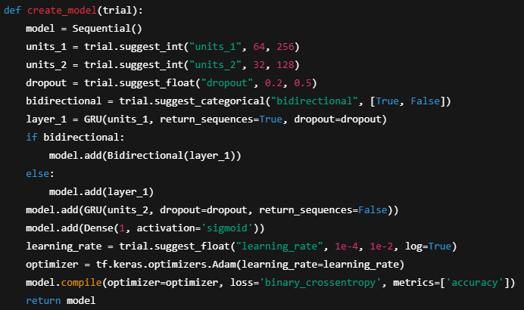
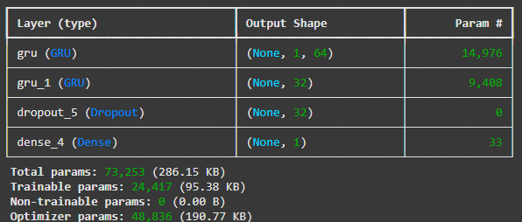
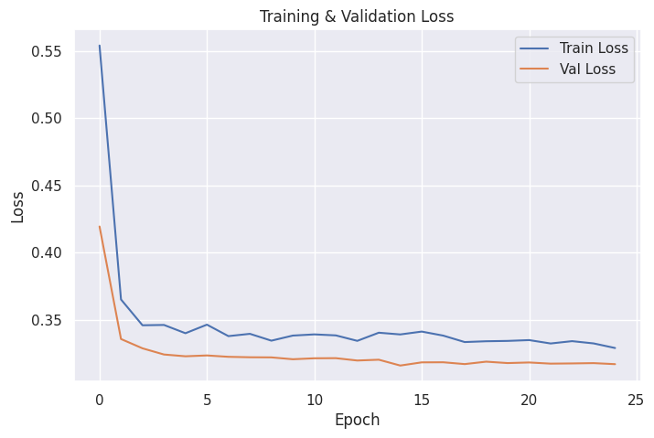
Hyperparameter Choices - GRU
Notes:
Deepak:
GRU (Gated Recurrent Unit) is a type of RNN introduced to simplify LSTM architecture while still solving the vanishing gradient problem.
It's faster and often performs similarly (or even better) than LSTM on many tasks involving sequential data
GRU has two gates instead of LSTM’s three:
Update Gate (𝑧ₜ) – decides how much of the past information to keep.
Reset Gate (𝑟ₜ) – decides how much of the past to forget.
Unlike LSTM, GRU merges the cell state and hidden state into one, which makes it:
Simpler
Faster to train
Uses fewer parameters
units:Number of neurons per GRU layer
dropout:Dropout for input connections
bidirectional:Wrap with Bidirectional for better context understanding

Slide 26
Ensemble – Different Combinations of Models
KNN worsened ensemble accuracy.
LSTM and GRU also did not improve ensemble accuracy.
A weighted average of lr, decision tree, Xgboost, NN, and CNNs results in the best score

Slide 27
Future Work
Incorporation of Additional Data Source
Use satellite imagery, radar data, or real-time weather station feeds to improve prediction accuracy
Incorporate topographical and elevation data to account for geographical rainfall patterns
Temporal and Spatial Modeling
Extend the model to spatio-temporal predictions (e.g., where and when it will rain)
Use recurrent neural networks (RNNs) or transformers for time-series forecasting.
Fairness
Distribution Bias, Omitted Variable Bias, Evaluation Bias, Generalization Bias
Notes:
Deepak
Augment external data sets like sate imagery, radar data, real time feed
incorporate topographical and elevation data to account for geo rainfall patterns
Temporal and spatial modelling
For future effort, we aim to address fairness challenges in rainfall prediction address omitted variable,, and generalization biases—to reduce overprediction, improve model reliability on unseen conditions.

Slide 28
Conclusion
Feature engineering, particularly time-based encoding and wind direction transformation, improved all models.
Neural models outperform simpler models on this task.
CNNs and recurrent architectures handle sequential dependencies well.
More complicated models are not necessarily better.
Ensemble modeling achieved near-top leaderboard performance on Kaggle (rank 21/4382).

Slide 29
References
Kaggle : https://www.kaggle.com/competitions/playground-series-s5e3/overview
Image: https://www.youtube.com/watch?v=Pn5NTfeKJzY
https://www.pivotalweather.com

Slide 30
Contributions
Mridul Jain: EDA, data pre-processing, lr, tree, xgboost, lstm, gru models building and tuning, slides preparation.
Lynne Wang: EDA, data pre-processing, lr, tree, xgboost, nn, cnn, knn models building and tuning, slides preparation.
Deepak Kumar Srivastava: EDA, data pre-processing, lr, tree, xgboost, nn, lstm models building and tuning, slides preparation.
Naresh Kumar Chinnathambi Kailasam: EDA, data pre-processing, lr, tree, xgboost, nn, lstm models building and tuning, slides preparation.
https://github.com/lwang9/mids-w207-final_project_team2

